Slide 1
Project title:- SECURE DATA HIDING USING STEGNOGRAPHY
Secure the data to prevent hackers
Presented By
Student Name : Sayan Mondal
College Name : Dinabandhu Andrews Institute of Technology & Management
Department: BCA

Slide 2
OUTLINE
Problem Statement
Technology used
Wow factor
End users
Result
Conclusion
Git-hub Link

Slide 3
Problem Statement
With the rise of cyber threats, ensuring secure communication has become a major challenge. Traditional encryption methods make data transmission secure but also attract attention from attackers. Steganography provides an additional layer of security by hiding sensitive information inside images, audio, or video files, making the data invisible to unauthorized users. This project focuses on implementing a secure data hiding technique using steganography to enhance privacy and security in digital communication.

Slide 4
Technology used
Programming Language: Python
Libraries: OpenCV, String, OS
Steganography Techniques: LSB (Least Significant Bit), DCT (Discrete Cosine Transform)
Security Enhancements: AES Encryption, Hashing Algorithms
Platform: Windows

Slide 5
Wow factors
Image-Based Steganography: Hides secret messages inside an image without altering its visible quality. Passcode Protection: Requires a password for decryption, adding an extra security layer. Fast & Lightweight: Uses OpenCV for efficient image processing. Minimal File Alteration: The modified image remains nearly identical to the original, preventing detection. Simple & Effective Algorithm: Uses pixel manipulation to embed messages securely. Cross-Platform Compatibility: Works on Windows and can be adapted for Linux/Mac.

Slide 6
End users
Government & Military: Secure communication of classified information.
Businesses & Corporations: Protect sensitive data from competitors.
Journalists & Activists: Safeguard confidential sources and reports.
General Users: Securely share private messages and files online.

Slide 7
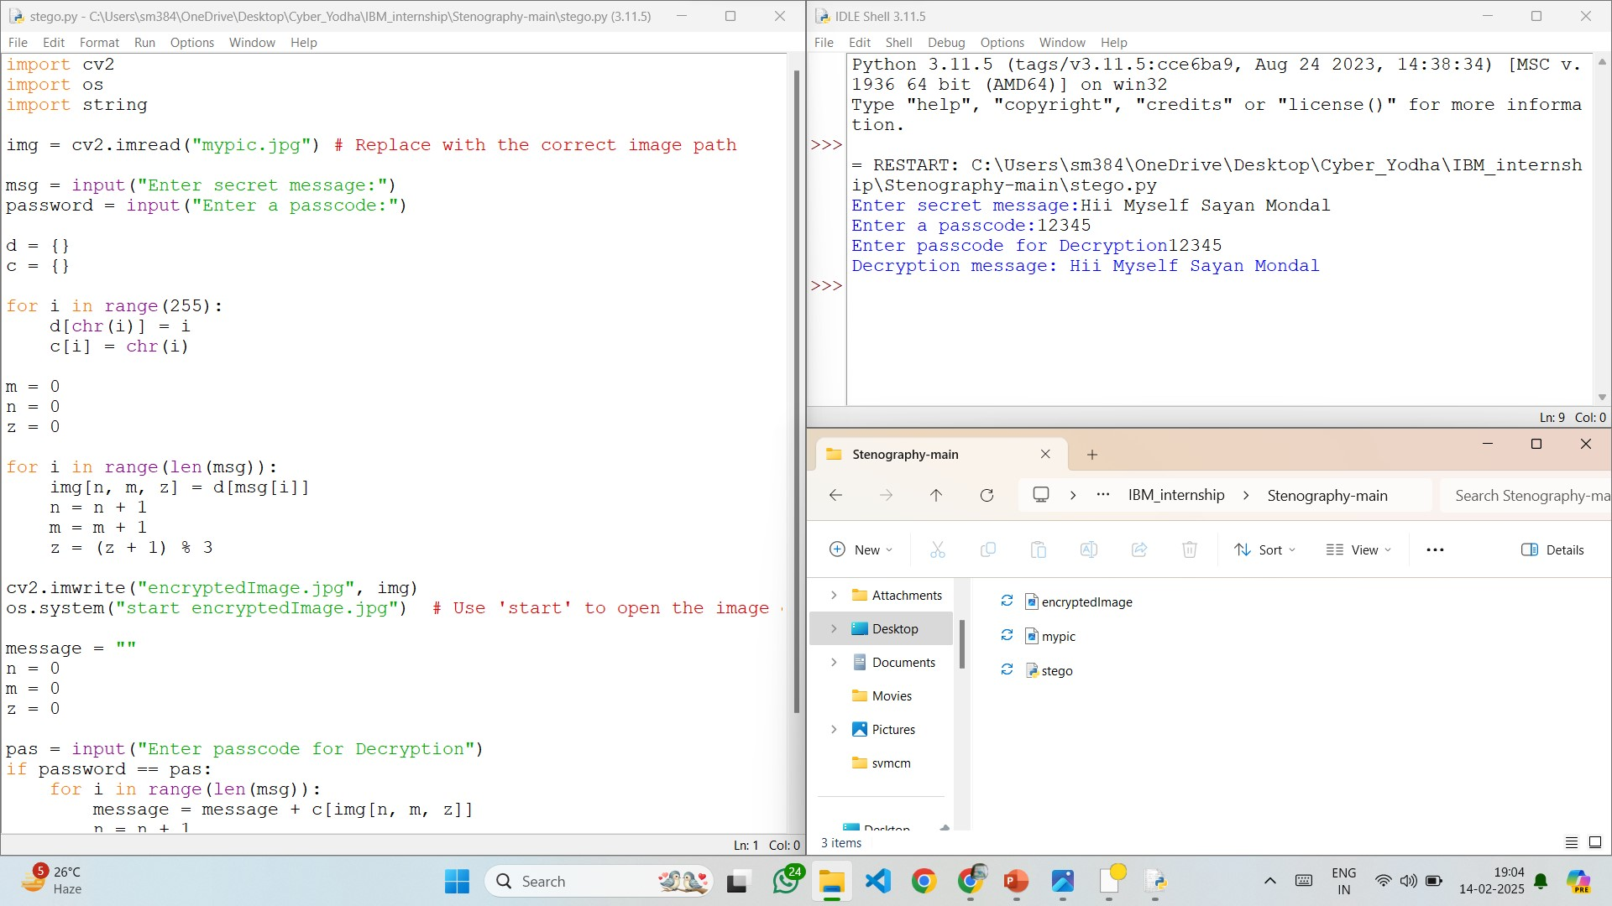
Results

Slide 8
Conclusion
Overall, this project highlights how steganography can enhance cybersecurity by providing an additional layer of protection against unauthorized access and data breaches. Future improvements may include support for audio/video steganography and stronger encryption methods for enhanced security.

Slide 9
GitHub Link
https://github.com/Sayan-8910/AICTE_PROJECT_2025.git

Slide 10
THANK YOU

